Slide 1
SpeakOut with Advocatr
Curriculum
Lesson 4
How to Gain Trust and How to Lose Trust

Slide 2
Debrief
How did you feel at the beginning of the exercise when the goal was to pass the beanbag as quickly as possible?
Did this exercise build trust or break it down for you?
What helped us achieve our task (complete the pattern without dropping the bag and/or to complete the pattern without dropping the bag as quickly as possible)?
What stood in the way?

Slide 3
Debrief (continued)
What happened when I suggested that it was your responsibility to ensure that your teammate caught the beanbag?
How did it feel to be responsible for someone else looking good?
How did it feel to know your teammate was responsible for making you look good?

Slide 4
Debrief (continued)
How might this game help us think about building trust? Losing trust?
How does being accountable or responsible to someone else relate to building trust? To losing trust?

Slide 5
Identifying Trust in Our Lives—Reflection Questions
Think of someone in your life that you trust. How did they gain your trust?
Think of a time when someone lost your trust. How did they lose your trust? How could/did they earn your trust back?
Reflect on a time when you gained or lost another person’s trust. What happened? If you lost someone’s trust, what could you do to earn their trust back?

Slide 6
Extension Activity 2
Creating Support Networks

Slide 7
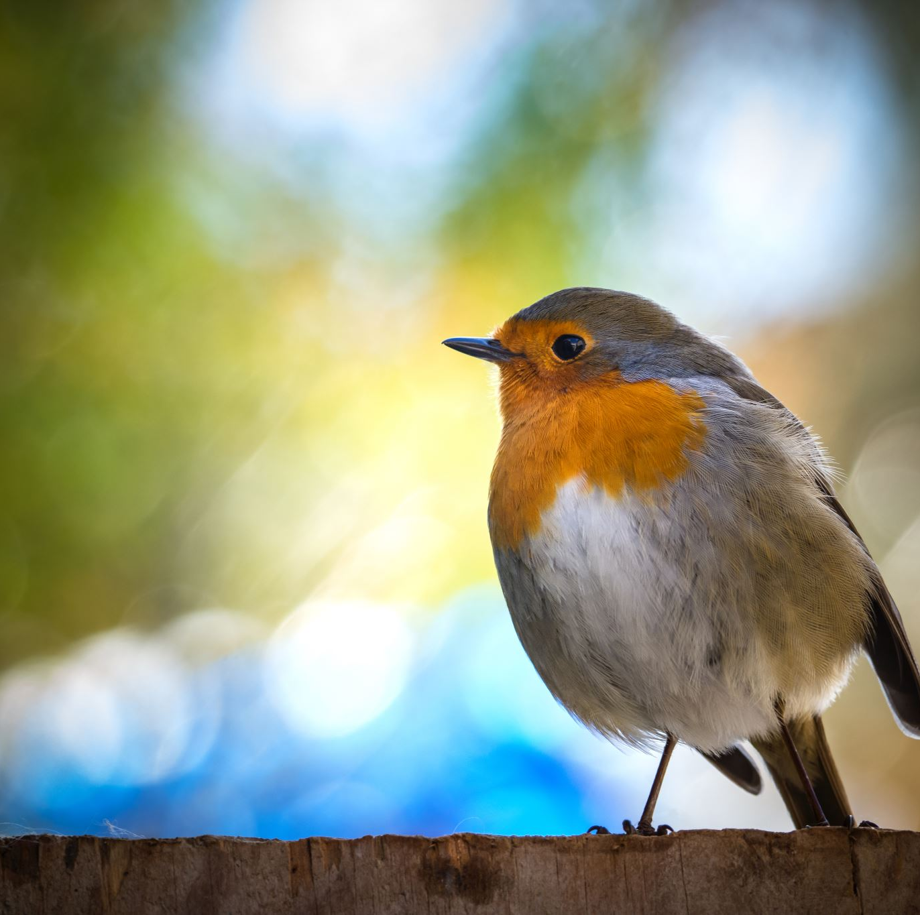
Quote of the Day
A person is a person through other persons. You can't be a human in isolation. You are human only in relationships.
-Archbishop Desmund Tutu

Slide 8
Molly
Molly's Support Network Map
Grandma
I don't see grandma very often, but I can tell her about my achievements and the things I’m proud of and she always celebrates with me.
My parents
When I have a problem I don't know how to solve, I talk to my parents and they give me good advice.
Mr. Whiskers (my cat)
Mr. Whiskers is really comforting when I just need to cry.
My best friend Isabella
I can talk to Isabella about anything. When I'm feeling upset, I know she will always listen.
Grandpa
He's not very good at talking about emotions, but when I just need to sit in silence with someone, I know I can go to grandpa.
Uncle Mike
He's hilarious. I know if I need to laugh, I can go to him.
Mrs. Smith (my History teacher)
When I'm having trouble with my family, I know I can go to Mrs. Smith.
Brittany (my soccer coach)
I go to her when I need advice about relationships.

